Slide 1
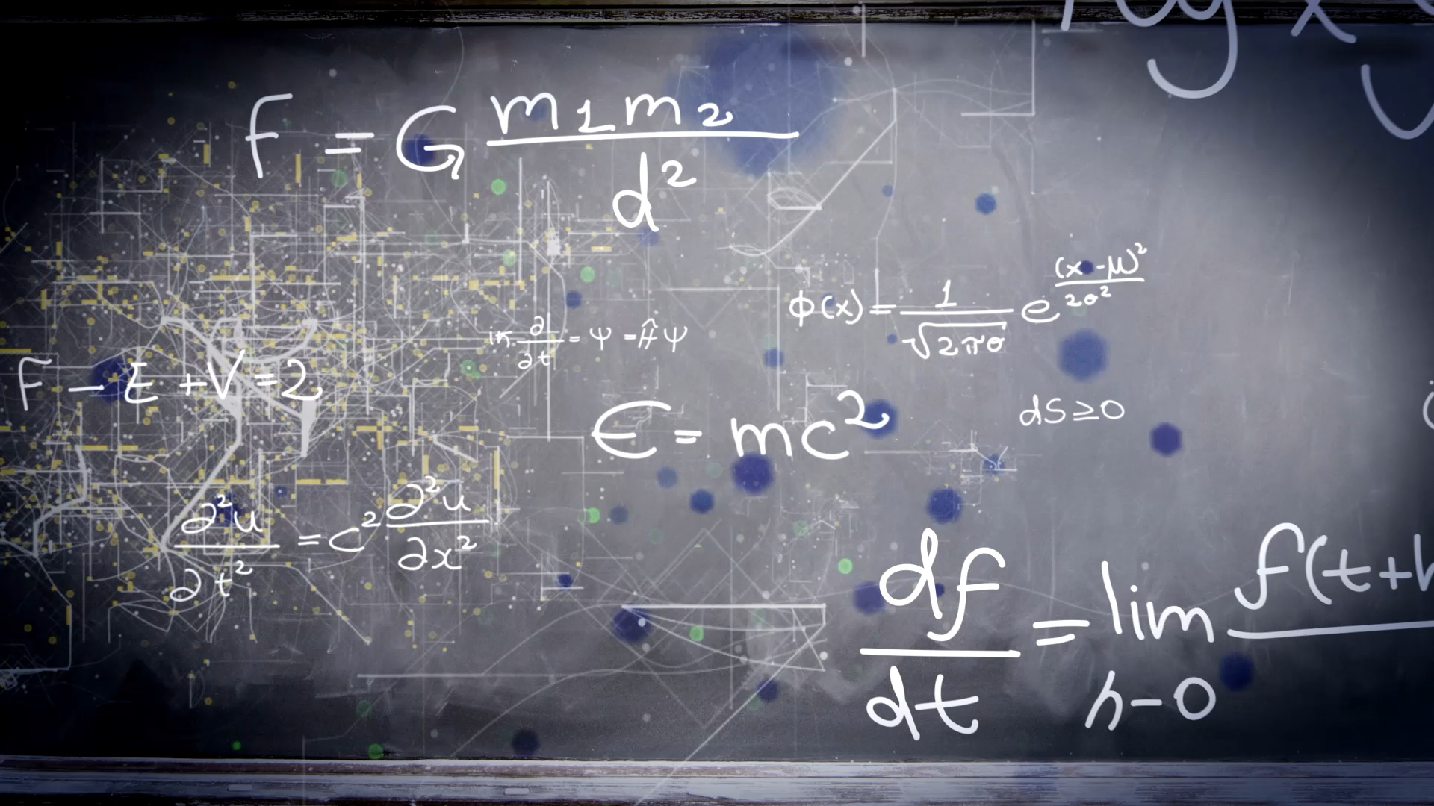
RRNet: Towards ReLU-Reduced Neural Network for
Two-party Computation Based Private Inference
Jiahui Zhao

Slide 2

ABSTRACT
Two-party computation (2PC) is promising to enable privacy-preserving deep learning (DL).
The 2PC-based privacy-preserving DL implementation comes with high comparison protocol overhead from the non-linear operators.
This work presents RRNet, a novel systematic framework that enables low latency, high energy efficiency & accuracy, and security-guaranteed 2PC-DL by integrating the hardware latency of the cryptographic building block into the neural architecture search loss function.

Slide 3
ABSTRACT
We develop a cryptographic hardware scheduler and the corresponding performance model for Field Programmable Gate Arrays (FPGA) as a case study.
The experimental results demonstrate that RRNet-A and RRNet-B achieve 63 ms and 228 ms latency on private inference on ImageNet, which are 147 and 40 times faster than the SOTA CryptGPU system, and achieve 70.54% & 78.79% accuracy and more than 1000 times higher energy efficiency.

Slide 4
Challenges
Machine-Learning-As-A-Service (MLaaS) has been an emerging solution nowadays, to provide accelerated inference for diverse applications. The current popular techniques to enable secure private inference (PI) includes multi-party computation (MPC) and homomorphic encryption (HE).
HE can only conduct shallow neural network (NN) PI and has significant encryption overhead.
MPC is good solution for deep NN but is expensive for non-linear operators such as ReLU.

Slide 5
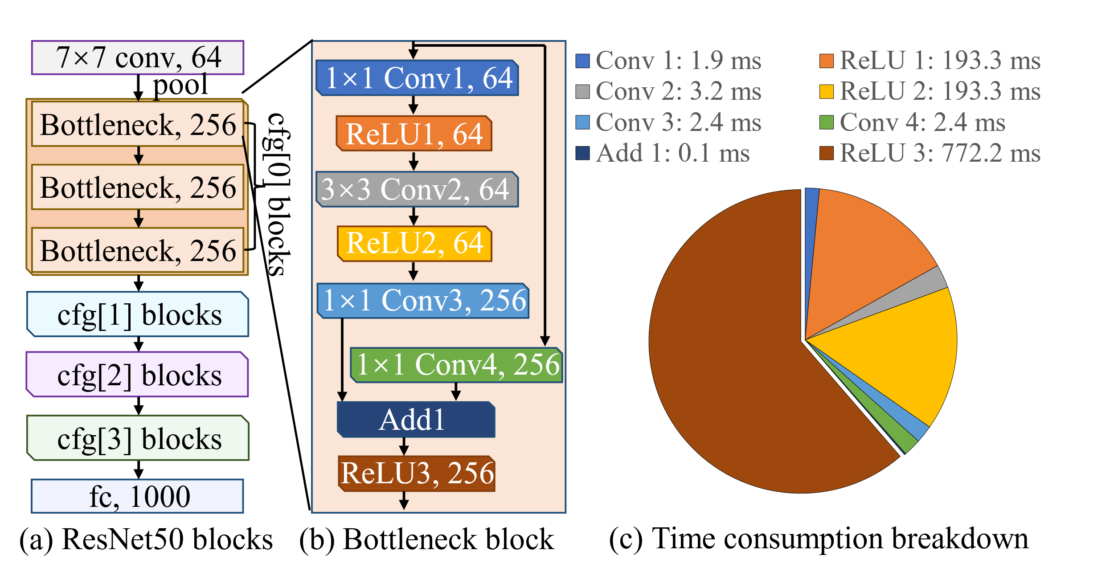
Challenges
The example above shows that the ReLU operator cost much longer evaluation latency than the Convolution operators.
To overhead challenges in MPC based PI, we need to replace ReLU with other polynomial operators, such as f(x) = wx + b or f(x) = w₂x² + w₁x + b. However, present NN architecture may not fit for such polynomial operators.
MPC based private inference overhead comparison

Slide 6
Preliminary
Overhead comparison of polynomial operator (Conv2D, MM) and non-polynomial operator (ReLU):
Multiplicative (polynomial) operator only requires single round communication, and required communication volume is small (few MBs).
Non-polynomial operator (ReLU) requires multi-party comparison, which can be realized through oblivious transfer, and the communication volume is large (GBs)

Slide 7
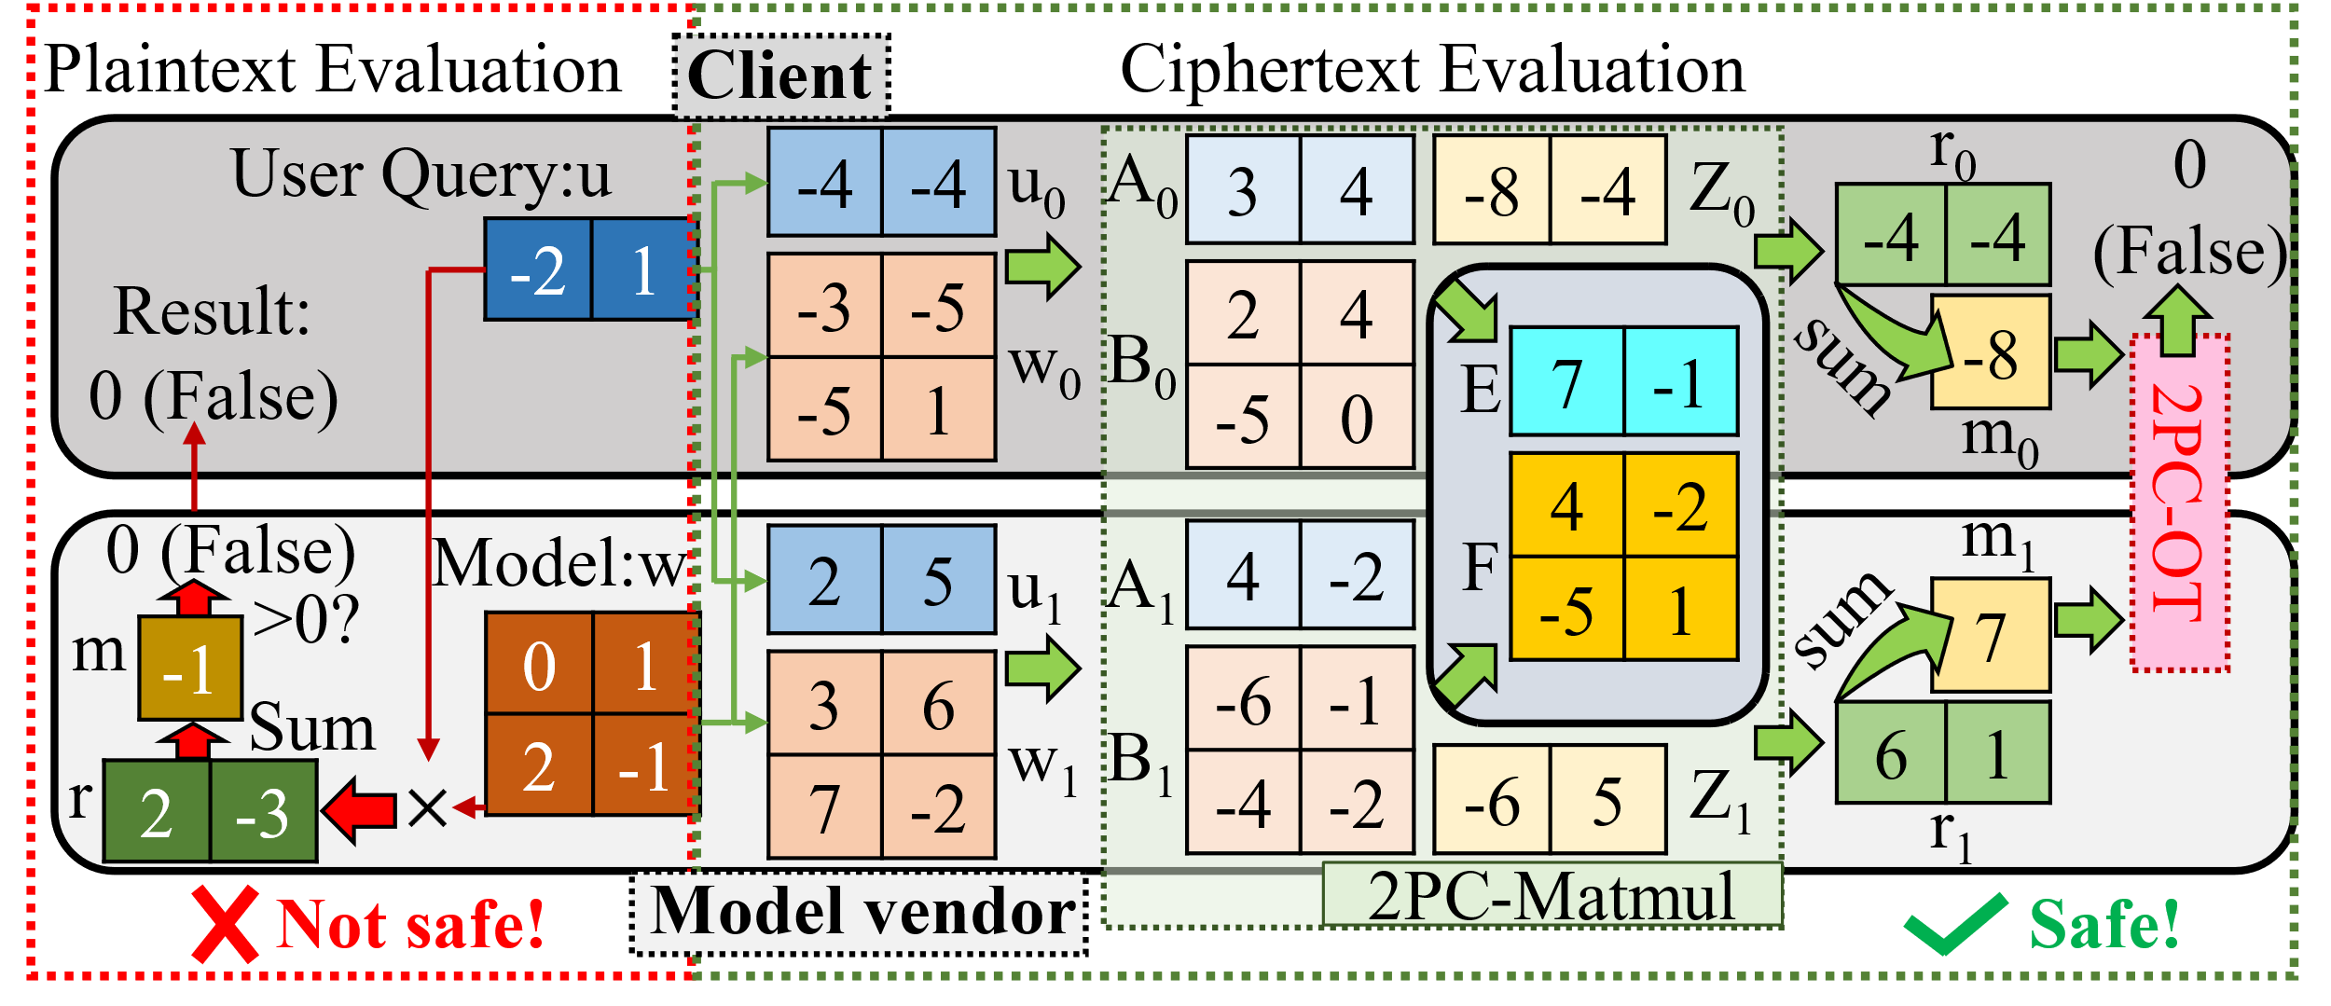
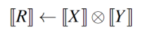
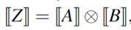
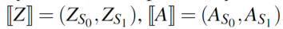
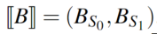
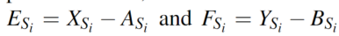
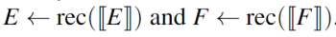
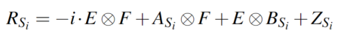
Preliminary – Multiplication in Cyphertext
Workflow of MPC based PI

Slide 8
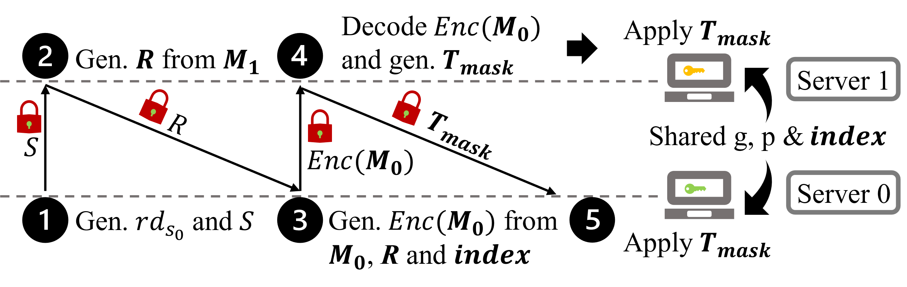
Preliminary – Comparison in Cyphertext (Crypten framework)
Oblivious transfer based non-polynomial operator workflow

Slide 9
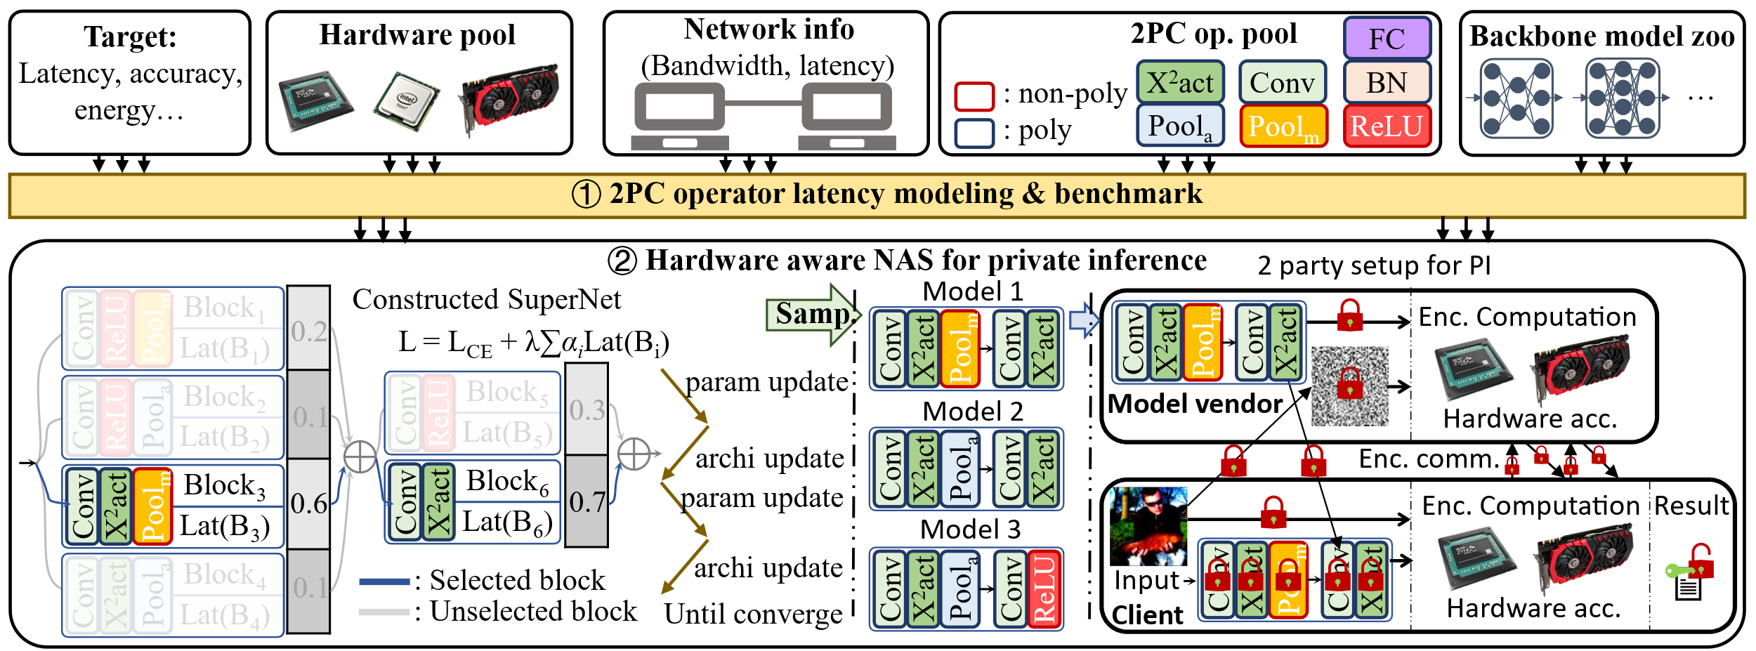
Proposed method and experiment result

Slide 10
Proposed method and experiment result
The method is evaluated on CIFAR-10 dataset. We use different basic architecture (MobileNet, ResNet18, ResNet34, ResNet50, VGG16) as a starting point, to search for an optimized architecture with different ReLU counts. Our work achieved a much better accuracy-ReLU count trade-off than SOTA works.
We select the proper NN architecture and evaluate on ImageNet dataset, and achieved much higher performance.

Slide 11
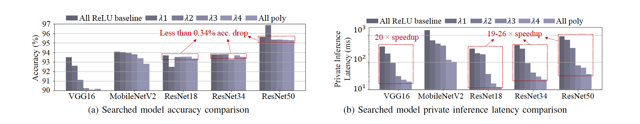
Proposed method and experiment result
RRNet framework evaluation under 2PC PI setup. Network banwidth: 1 GB/s. Device: ZCU104

Slide 12
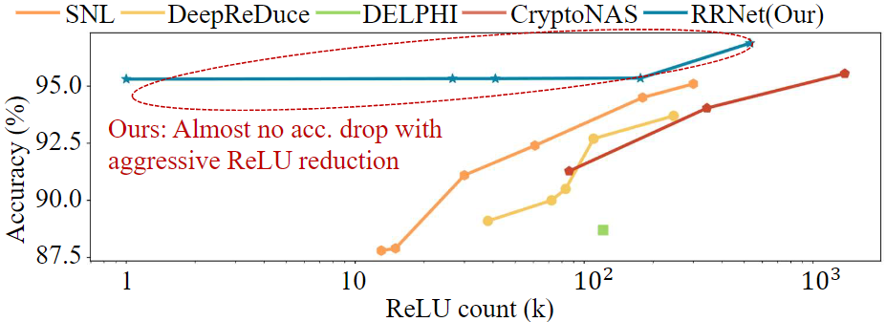
Proposed method and experiment result
Accuracy-ReLU count cross-work comparison
SNL: Selective network linearization for efficient private inference
Delphi: A cryptographic inference service for neural networks
Deepreduce: Relu reduction for fast private inference
Cryptonas: Private inference on a relu budget.

Slide 13
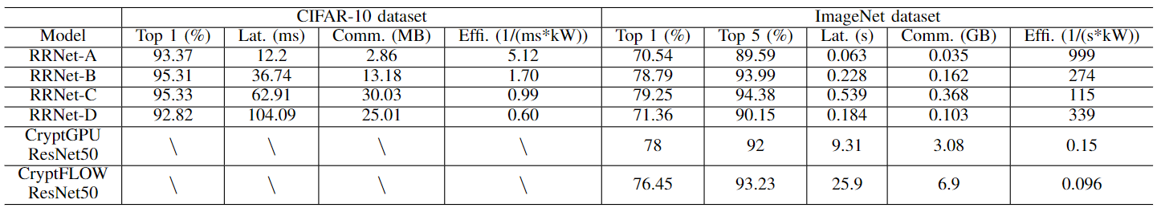
Proposed method and experiment result
Table 1: RRNet evaluation & cross-work comparison with CryptGPU and CryptFLOW . Batch size = 1
Cryptflow: Secure tensorflow inference
Cryptgpu: Fast privacy-preserving machine learning on the gpu

Slide 14
CONCLUSION
In the work, to reduce the high comparison protocol overhead from the non-linear operators in 2PC-based privacypreserving DL implementation, we propose the RRNet framework that enables low latency, high energy efficiency & accuracy 2PC-DL. Experiments show RRNet achieved a much higher ReLU reduction performance than all SOTA works on CIFAR-10 dataset.

